Slide 1

Open access to your publications
Aysa Ekanger, PhD
University Library of Tromsø
CASTLFish, 20.02.2018

Slide 2
Open Access content
Scholarly articles and monographs, research data, software, pictures
digital,
online,
free of charge,
and free of most copyright and licensing restrictions.
AUTHORS have the right to be properly acknowledged and cited.

Slide 3
Why go open?
Because it’s the right thing to do:
  Better for science
  Better for the society
  Better for the researcher
Because you may have to:
  National policy
  Funders’ policies
Notes:
You don’t publish for the money, but to move science forward, to contribute to the wealth of human knowledge. And you can do so in the most efficient way if you don’t lock up your publications behind payment walls in subscription journals.

Slide 4
Examples of OA in linguistics?
Glossa
Borealis, Nordlyd, Poljarnyj Vestnik
Open Library of Humanities, the megajournal
LingBuzz
WALS
Lexicon of Linguistics

Slide 5
How to go open
Publish OA
  In an OA journal
  As (a chapter in) an OA monograph
Make your work available in an open repository (self-archive)

Slide 6
What is an «Open Access journal»?
an OA journal:
Reader has free access.
Author retains copyright.
Reader may have reuse rights.
Maximum distribution.
a subscription journal:
Reader must pay.
Publisher seizes copyright.
Reader has no reuse rights.
Limited distribution.
Became possible with the internet
The only mode before 1990s
May vary: quality, prestige, editorial processes

Slide 7
A super-short history of scholarly publishing
1665
Learned society journals
(Peer review from 1831)
1860s
Independent journals
(Peer review from 1970s)
1940s
BIGGER volume of scientific publications
Commercial publishers start buying up society journals
1970s
Journal prices outstrip inflation.
And they are still rising.
Around 1990
1st OA journals
1st subject repository (arXiv)
Subscription journals go online
Nowadays
OA is gaining ground – slowly.

Slide 8
How to choose an OA journal
Checkpoints:
Norwegian Register for Scientific Journals, Series and Publishers (NSDs kanalregister)
Directory of Open Access Journals (DOAJ)

Slide 9
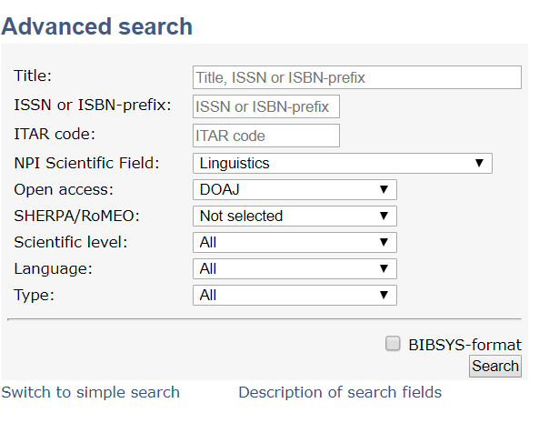
Do you want publication points for the article?
Norwegian accreditation system for all journals (OA & subscription)
Journal must be level 1 or 2.
Cross-check with DOAJ to be sure that the OA information is up to date.
NB! You can also suggest new journals for accreditation.
https://dbh.nsd.uib.no/publiseringskanaler/Forside

Slide 10
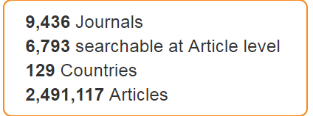

The Directory of Open Access Journals (DOAJ)
DOAJ indexes high quality, open access, peer-reviewed journals.
Journal in DOAJ, but not accredited?
Suggest it as a new channel to the Norwegian Registry.

Slide 11
Article Processing Charges
Author-side charges that cover publishing costs
Have existed long before OA & internet
  Some subscription journals charge for graphs, images, additional pages…
Some OA journals (30 % in DOAJ) have APCs
  When readers don’t pay for access, financing has to come from somewhere
Vary greatly in size: legacy publishers tend to have higher APCs

Slide 12
Open Library of Humanities
Cross-disciplinary peer-reviewed OA megajournal, all languages
Platform hosts specialized journals. In Linguistics:
  Glossa
  Laboratory Phonology
  Journal of Portuguese Linguistics
Free to publish in
  Encourages authors with publication funds to pay
  UiT is a sponsor for OLH, so it’s absolutely free for you

Slide 13
OA monographs
Language Science Press
high quality, peer-reviewed open-access books in linguistics
stand-alone books and series
free for authors – no Book Publishing Charges
General Editors: Stefan Müller and Martin Haspelmath

Slide 14
OA monographs
Stockholm University Press
  Wholly OA publisher
  Rigorous peer-review
  Modest Book Publishing Charge
Knowledge Unlatched
  Are you publishing with a non-OA publisher? Ask the publisher whether your book can be considered for OA through this project.
  UiT is a sponsor of KU
Universitetsforlaget (Scandinavian University Press), Cappelen Damm

Slide 15
UiT Publication fund
OA article or chapter
OA monograph
Max APC NOK 25 000 incl. VAT
Journal must be listed in the Directory of Open Access Journals
No max BPC – case-by-case judgment
Only corresponding author (must be UiT-affiliated) can apply.
Only publishing in accredited publication channels (journal, publisher, series) - level 1, 2
Apply to the fund before you submit the manuscript.

Slide 16
SELF-ARCHIVE!*
Have not found an OA publishing channel?
*Also if you do publish open access.
Notes:
If you publish OA, self-archiving might seem like unnecessary extra work. But there are reasons why you should do it:
Several dissemination channels increase visibility of your publication.
Archiving your work in a repository is back-up: in case the primary dissemination channel goes out of business or locks up

Slide 17
Archive your work in an open repository
«Self-archive» a manuscript version
  Check Sherpa/ROMEO for the journal’s/publisher’s archiving policy
    preferably before you submit
  Most journals/publishers allow archiving of
    Preprints (submitted manuscript, before peer review)
    and/or postprints (accepted manuscript, after peer review & before formatting).
  Often with embargo
If you have published OA, you can self-archive the published version.
  Widens the distribution
  Back-up

Slide 18
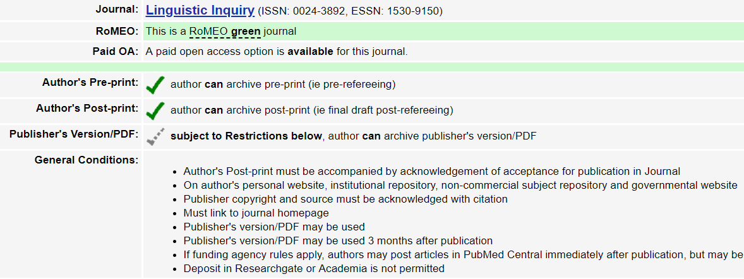
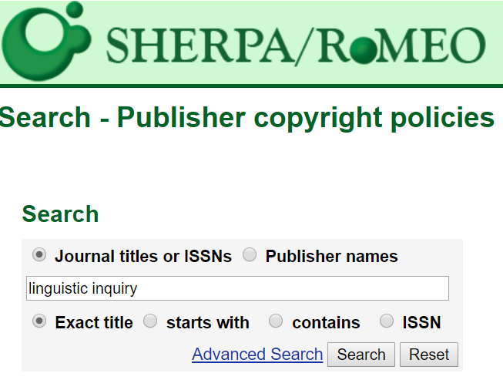
http://www.sherpa.ac.uk/romeo/search.php

Slide 19
Archiving in UiT’s open repository, Munin
Find the article in Cristin and upload fulltext pdf.
  Usually the accepted manuscript version
The library will check the journal’s policy and make it openly available in the Munin repository.

Slide 20
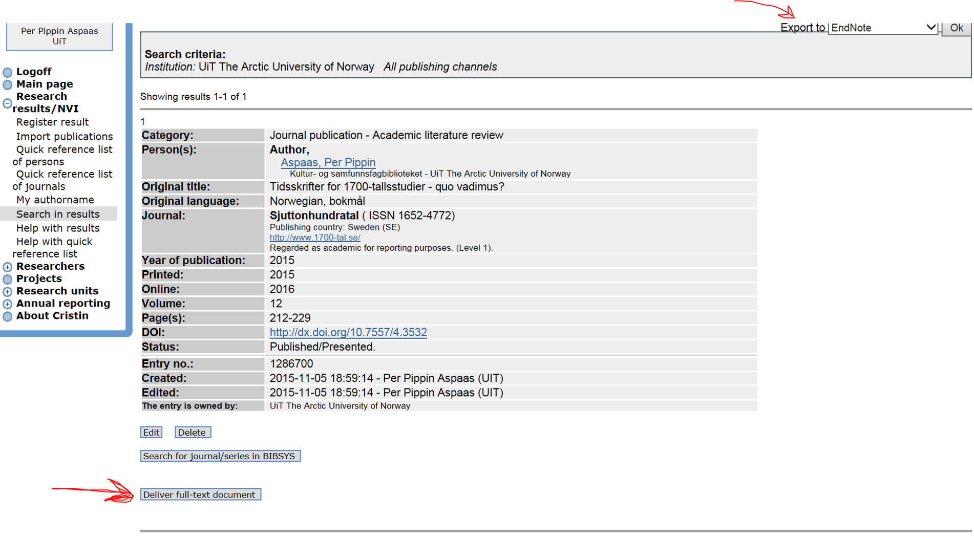

Slide 21
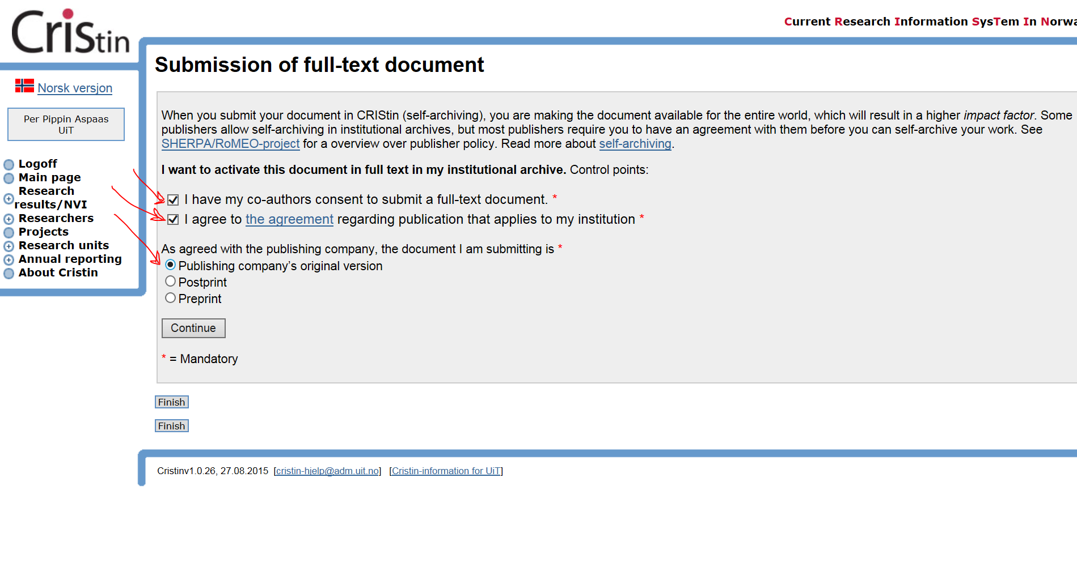
Submit published version if you are sure that it can be self-archived.
Otherwise, submit postprint.

Slide 22
Author addendum
A subscription journal does not generally allow self-archiving?
Use an Author addendum in your publishing contract.
NB! This step is not recommended for projects that have a self-archiving obligation, as it is not guaranteed that the publisher accepts the addendum.

Slide 23
So what are the requirements in all those policies?

Slide 24
National policy, 2017
Applies to journal articles
Deposit
  Obligatory, no exceptions
Self-archive
  Obligatory
  You can choose a journal that does not permit self-archiving only in exceptional cases
    E.g. there are no other recognized journals in your field
Publish OA
  Recommended
National goals and guidelines for open access to research articles

Slide 25
Funders’ policies
European Research Council and Norwegian Research Council
Applies to journal articles
Encouragement to publish OA
Obligatory archiving in an open repository
Published version or accepted manuscript
  Maximum allowed embargo for humanities – 12 months
  Funding can be held back until the self-archiving requirement is satisfied.

Slide 26
Funder requirements? Important to plan!
Secure the accepted manuscript version
Co-authors?
  They need to agree to your self-archiving.
  At the start of the process, send all authors an e-mail stating that you will only participate if you can self-archive the article manuscript.
The author with the strongest OA “needs” dictates the OA level.
EU or NRC funding?
  Make sure the corresponding author does not send the manuscript to a journal that prohibits self-archiving.
  Otherwise it can be impossible – or costly – for you to fulfil your obligations.

Slide 27
And then there’s research data…

Slide 28
Principles and guidelines for research data management at UiT
Applies to:
  All research conducted by UiT employees
  Research funded by UiT
  Projects/research started after 1 September 2017
    Recommended for projects/research that started before 1 September 2017.
The researcher shall:
Write a data management plan in an early phase of the project.
Ensure secure storage, back-up and archiving.
Equip the data with standardized metadata.
Make the data openly accessible.
  As early as possible
  With appropriate licenses
  Exceptions: security, personal privacy, commercial or legal issues.
UiT shall provide training, support and infrastructure
For more info: Forskningsdataportalen UiT

Slide 29
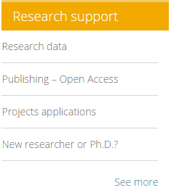
https://uit.no/ub
Would you like to learn more about scholarly publishing?
The 13th Munin Conference on Scholarly Publishing
End of november 2018, UiT
Free for UiT employees and students
http://site.uit.no/muninconf/
Questions? Contact us! oa@ub.uit.no
Munin repository munin@ub.uit.no
Publication fund fond@ub.uit.no

