Slide 1
GLOSS kick off meeting
29-30 September 2022
University of Borås – some partnerships in the global south
Ellinor Skaremyr, Getahun Yacob Abraham, Veronica Trépagny

Slide 2
University of Borås areas of education
Library and Information Science
Behavioural and Education Sciences
Business and Informatics
Engineering
Fashion and Textile Studies
Health Sciences
Police Education

Slide 3
Some numbers
Students
Registered students: about 18,300
Full-time equivalent students: 6,736
Breakdown by level
Bachelor’s level: 86%
Master’s level: 14%
Employees
Number of employees: 803 (of which 63% are women and 37% are men)
Number of teaching staff: 482 (of which 55% are doctoral students)
Research
Number of professors: 48 (of which 33% are women and 67% are men)
Number of doctoral students: 65 (of which 72% are women and 28% are men)
Number of doctoral theses: 19 (16 granted by the university)

Slide 4
Internationalisation at the University of Borås
The University of Borås is an internationally attractive higher education institution where internationalisation contributes to high quality education and research.
The University of Borås is an active partner in international knowledge development, which equips students and employees to contribute to sustainable development.
The goals are achieved by:
  By integrating internationalisation and a global approach into the university's structures, routines, and systems for quality assurance and the quality development of education and research.
  By developing and nurturing international networks and partnerships for exchange and knowledge development.
  By actively contributing to academic freedom and democratic values in accordance with Agenda 2030
Notes:
(Aim, where and which students, length of practicum, collaboration with Partner in South, focus upon opportunities and challenges, research)

Slide 5
Sida Research Training Partnership Programme
University of Rwanda, Rwanda, 2013--
Makerere University, Uganda, 2015-2022
Universidade Eduardo Mondlane, Uganda, 2017--
  PhD students, research culture, capacity building, exchange
Notes:
(Aim, where and which students, length of practicum, collaboration with Partner in South, focus upon opportunities and challenges, research)

Slide 6
Other programmes or bilateral exchange
Makerere University, Uganda, Erasmus+ICM, LP (LIS, Education in the process)
Murang’a Teachers’ Training College, Kenya, former exchange, in the process
University of Gunadarma, Indonesia, psycology, education, IT, business
Panyapiwat Institute of Management, PIM, Thailand, bilateral, mainly IT
Networks

Slide 7
First and foremost, the teaching method at the University of Borås was one of its kind. I enjoyed the fact that we used to handle a course unit at a time. This was something completely new to me which I enjoyed so much because it would give me enough time to concentrate on one thing and thus perform to my best. […]
The other interesting thing was the number of lecturers teaching a single course unit. At our Makerere University we were used to having only one lecturer per course unit which was totally different in Sweden, Borås, where almost three lectures or teachers taught just one course unit. This was challenging to me but in good way since it taught me to be flexible as a student.
Student I from Uganda, Semester 1, 2021

Slide 8
Despite the stories and cautions we heard/received before our travel about issues to do with racism, the people were generally helpful whenever we needed assistance. Being social for the Swedes is a bit challenging generally, but we eventually made some friends who were helpful in the social aspects of the town. The language was challenging at first, but the Swedish lessons played a great part in easing communication because we were able to understand each other.
Student iv from Uganda, Semester 1, 2021

Slide 9
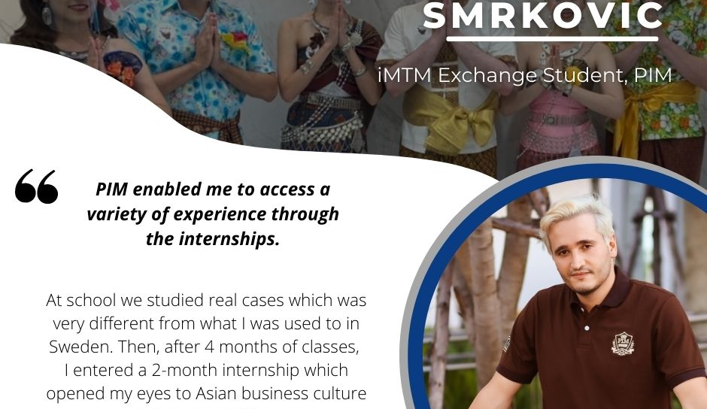

Slide 10
Challenges and opportunities
ADMINISTRATIVE
Educational systems
Teacher training vs. pre-school teacher training
Curricula
Mobility windows
Semester planning and dates
Credit recognition – courses and internship
OTHER
Relations inside and outside of campus
Reciprocity -- students
Notes:
(Aim, where and which students, length of practicum, collaboration with Partner in South, focus upon opportunities and challenges, research)

Slide 11
Thank you!

