Slide 1
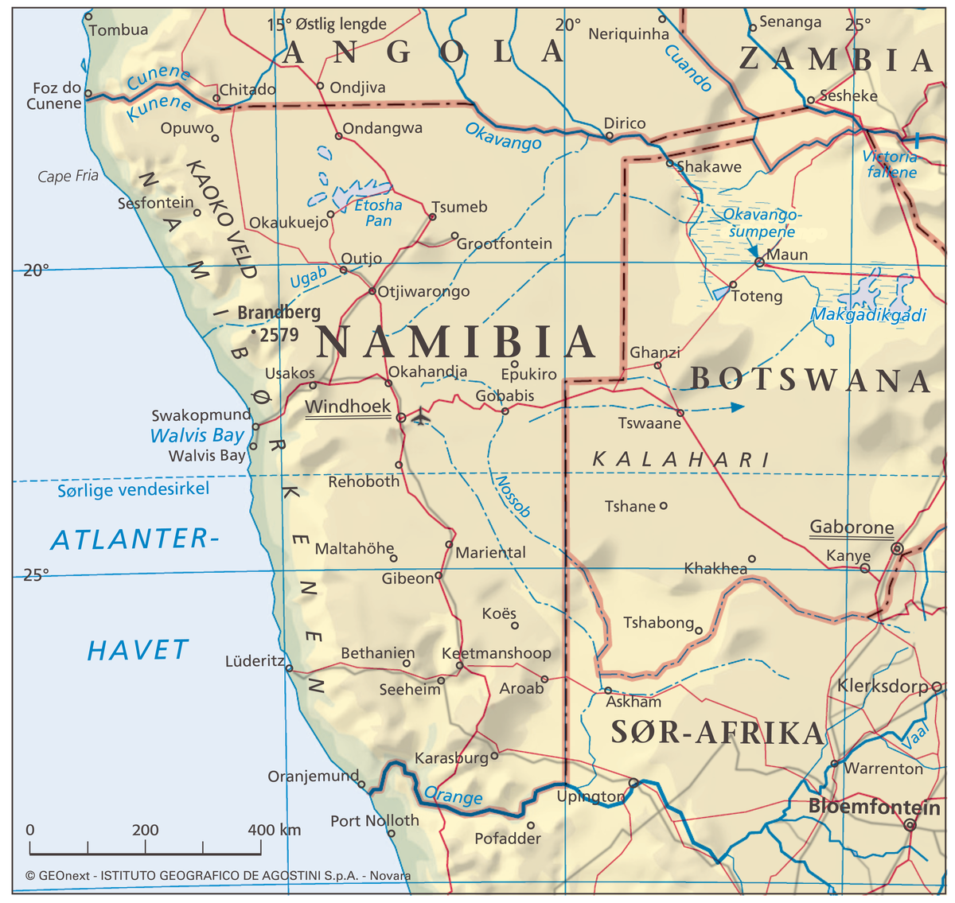
Faculty of Teacher Education Cooperation with Namibia
2005-2022
PROFESSOR OF GEOGRAPHY GERD WIKAN

Slide 2
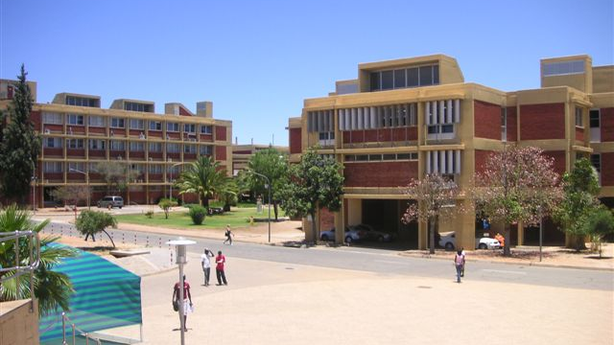
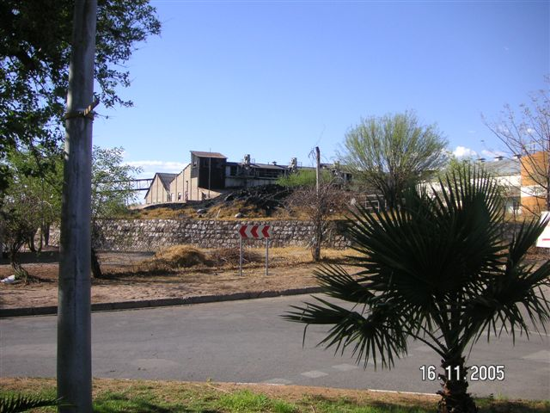
Research and Exchange since 2005
UNAM
Ministry and Oshikoto Region
Student exchange
Research
Academic programme
Norwegian students school based training in Tsumeb and Ondangwa

Slide 3
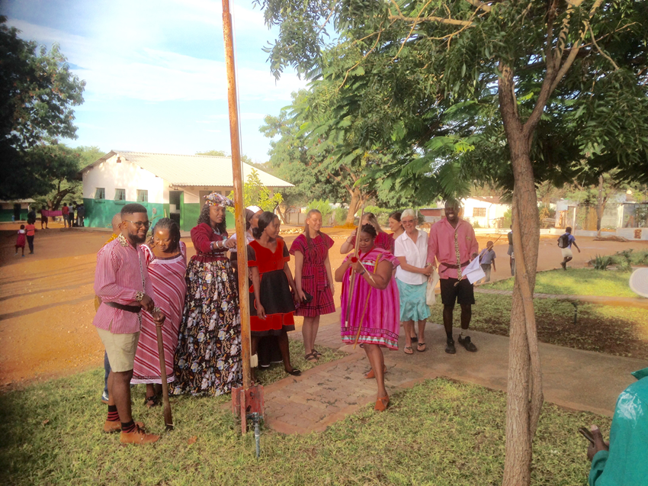
Aim of international practicum in the Global South
Global competence
Enhance the students’ intercultural competence
Enhance the students’s global awareness

Slide 4
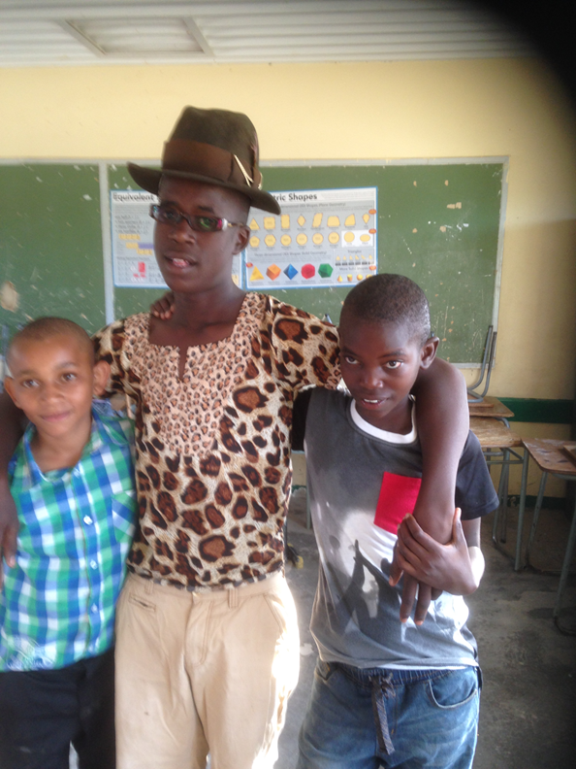
Three «programmes»
3 month one-way programme N -S
5 weeks exchange programme
Digital exchange programme

Slide 5
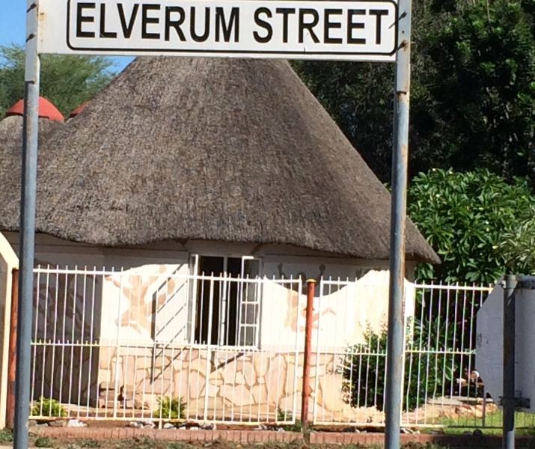
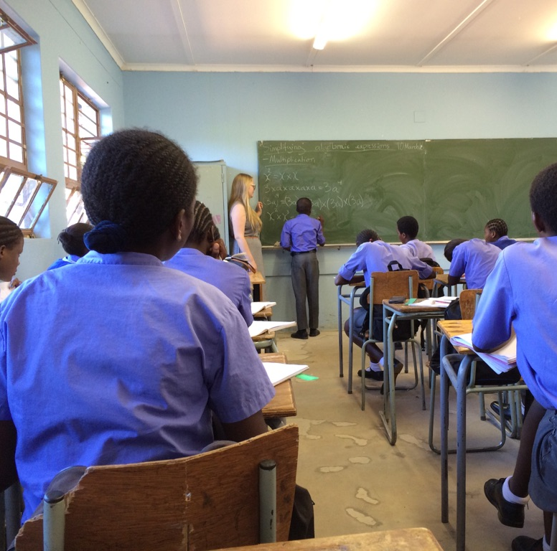
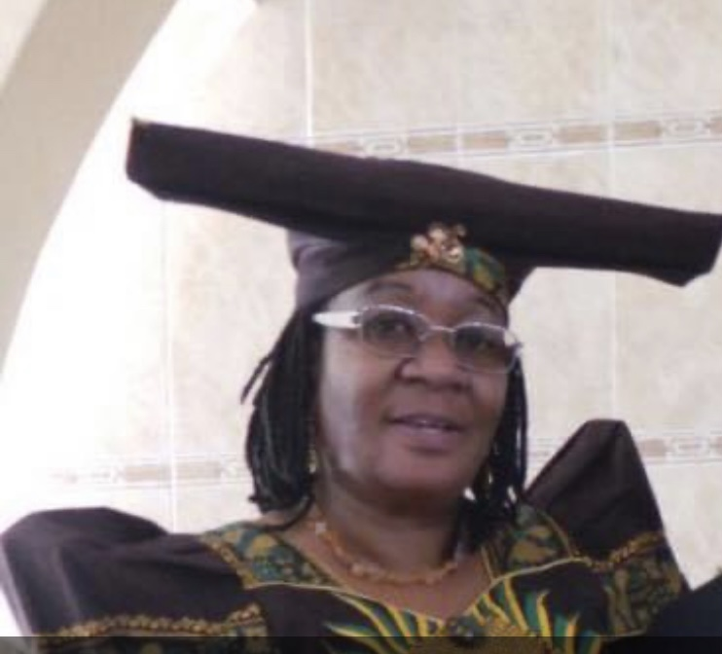
3 months programme 2005-….
MoU with Ministry of Education (since 2005)
Teacher Education Students Practice in Tsumeb (3 months)
Primary school, Pre-school education
TTRC coordination with schools, receive of students and accommodation

Slide 6
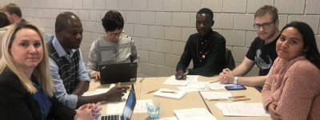
Multicultural practicum groups
Exchange programme 2019-2024
Students and staff
Partners: Polen, Sweden, Namibia, INN
Student teachers get scholarship
Mixed practicum groups.
International at home and abroad.

Slide 7
Digital exchange
Students meet twice digitally
The first task could thus be something like:
short description of the teacher education programme with regards to practicum.
explains the tasks that has to be completed over 3 years
describes important aspects/views on the child the aims of education from the country
The second task will then focus on how these "ideals" play out in the classroom.
What do they observe?
Descriptions of teacher and learner activities and interactions.

Slide 8
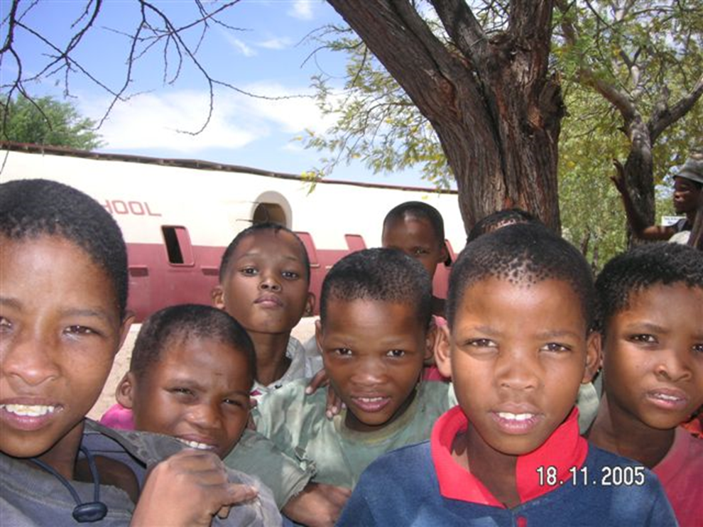
The programme
Pre-departure
Orientation cource
Practicul preparation
In –country
UNAM partner
Local partner
Inn lectures
Re-entry
Research
Global awareness
Personal growth
Intercultural competence

Slide 9
Research outcome
Wikan, G. (2008). Challenges in the primary education in Namibia. In Bluma et.al analyses of Comparative Education Policies. Ersmuskonferanse,rapport, Linz
Wikan, G., Mostert, M. L., Danbolt, A. M. V., Nes, K., Nyathi, F., Hengari, J., et al. (2007). Reading among grade six learners in Namibia and Norway: an investigation of reading habits and attitudes of learners in the Khomas and Oshana regions of Namibia and the Hedmark region in Norway. Høgskolen I Hedmark.
Wikan, G., & Mostert, M. L. (2008). Reading habits and attitudes of primary school pupils in Namibia and Norway. Education as Change, 12(1), 95-107
Wikan, G., & Mostert, L. (2011). Home environmental factors influencing performance and progress of primary school pupils in Windhoek. Ghana Journal of Geography, 3, 19.
Wikan, G. N. (2015). What did you learn in school today? A study of learning achievements in primary schools in Namibia. Tojned: the Online Journal of New Horizons in Education, 5(1), 139-147.
Wikan, G. N., & Klein, J. (2015). Global perspectives in teacher education: a study of international practicum ATEE annual conference 2014 - Transitions in teacher education and Professional identities. Proceedings of ATEE 39th Annual Conference - Association for Teacher Education in Europe.
Wikan, G. & Klein, J. (2016). An investigation of student teachers’ professional development following a teaching placement in Southern Africa. In Proceedings of ATEE 40th Annual Conference - Association for Teacher Education in Europe. Glasgow, 22-31.
Wikan, G. & Klein, J. (2017). Can International Practicum Foster Intercultural Competence Among Teacher Students? Journal of the European Teacher Education Network (JETEN) 2017; Volum 12. (1) s. 95-104
Wikan, G. & Olsen, S.T. (2018). Intervention in international practicum in the Global South. Association for Teacher Education in Europe 2018 s. 356-367 HINN OSLOMET
Olsen, Sissel Tove; Wikan, Gerd Nora; Klein, Jørgen; Hagen, Anikke (2019). Praksisstudier i fremmed land- bedre lærere i eget land?. I: Teoretiske og praktiske kunnskaper i lærerkvalifisering - sammenhenger og spenninger. Universitetsforlaget 2019 ISBN 9788215030715. s. 131-147 HINN OSLOMET
Klein, Jørgen; Wikan, Gerd Nora (2019). Teacher education and international practice programmes: Reflections on transformative learning and global citizenship. Teaching and Teacher Education : An International Journal of Research and Studies 2019 ;Volum 79. s. 93-100 HINN
Wikan, Gerd Nora (2020). Global teachers: The long-term effects of an international practicum. Association for Teacher Education in Europe 2020 ;Volum 44. s. 62-79 HINN

