Slide 1
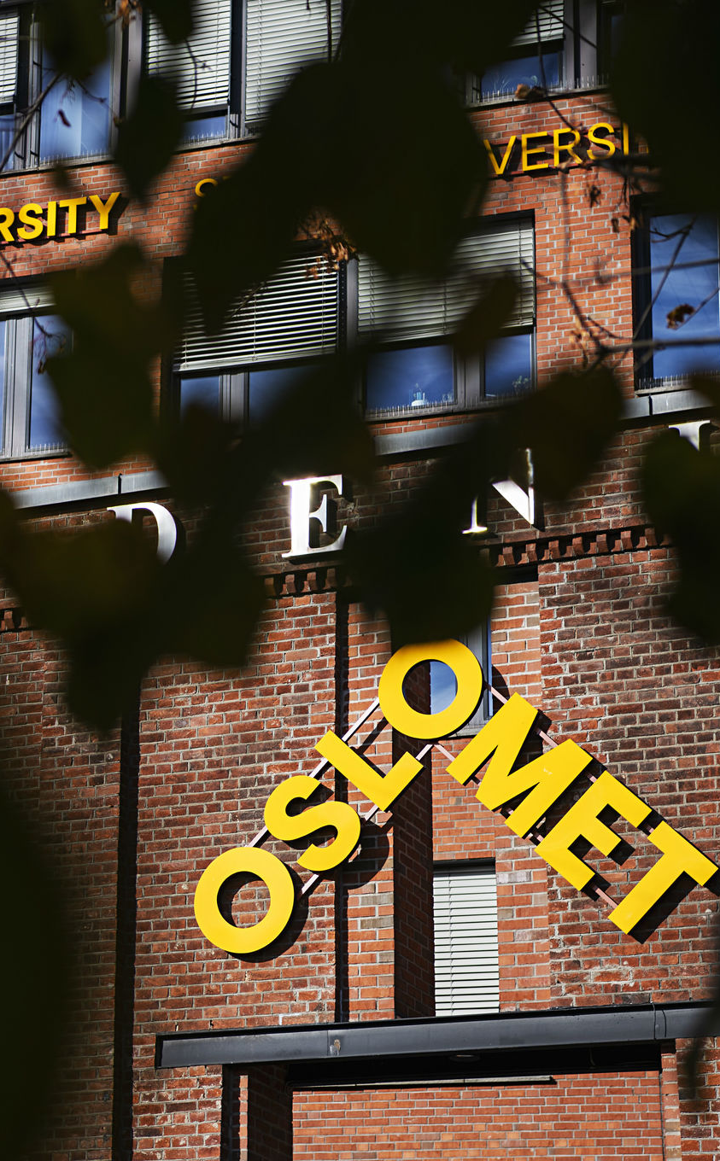
Introduction
Global Teaching for Sustainable Society 2022-23/25, Nordplus fundings
Hege Knudsmoen 29.09.2022

Slide 2
Global Teaching for Sustainable Society
GLOSS is a new Nordic initiative to strategically bring together Nordic teacher institutions which have student teachers in internship with our partners in the Global South.
The objectives of the network is to strengthen global consciousness and intercultural competence among teacher educators and teacher students in the Nordic countries with collaboration with the Global South to enhance UN’s sustainable development goals.
We need to elaborate upon how the Nordic teacher education institutions together can develop intercultural competence, global consciousness and concrete challenges and actions connected to UN’s sustainable development goals (SDG) by bringing our students together virtually and physically and reduce post cultural thoughts.
We will share knowledges and build competences for students teachers in internship with our partners in the Global South, by this collaboration we aim to elaborate a development project.

Slide 3
GLOSS development project 2022-25
The overall purpose of this development project is a joint Nordic effort to develop international teacher education practicums that support multicultural and global learning outcomes for students and lead to more competent teachers for the future global classroom.
The GLOSS network will concretize the development project in 2022, by a new application to Nordplus,1st February 2023.
International practicum in the Global South or North can be a way of providing opportunity for Nordic student teachers to develop these sustainable competences, becoming interculturally competent is a developmental process.
How can we involve partners in the Global South in the next application or other Nordic countries?

Slide 4

Background:
Global and Intercultural Competence for Teacher Students through Practicum in South (GIPS), 2016-22

Slide 5
Milestones GLOSS, 2022-2025
Semester | Aug-Dec 2022 |  | Jan-June 2023 |  | Aug-Dec 2023 |  | Jan-June 2024 |  | Aug-Dec 2024 |  | Jan-June 2025
Working seminars face-to-face | x |  | x |  | x |  | x |  | x |  | x
Thematic working group Virtual meeting |  | x x | x x | x x | x x | x x | x x | x x | x x | x x | x x
Steering group meetings | x |  | x |  | x |  | x |  | x
Finale conference |  |  |  |  |  |  |  |  |  |  | x
Other activities?

Slide 6
Friday 30th September
Pilestredet 46, KK-lounge, OsloMet
0900 Plenary: Discuss concrete development work and issues
1000 Divide into groups: group discussion and virtual work until next meeting
1130 Summing up upcoming collaboration
1200 Lunch meeting before leaving home

Slide 7
Thematic group, to be discussed on Friday
- Nordic Perspectives on
Internationalization at home in higher education
Global knowledge and - learning
Intercultural competence and - communication
Ethics
Decolonizing the curriculum
SDG, Education 2030
Internship or practicum in the Global South
Virtual mobility in collaboration North- South incl. COIL
“We aims to develop and share knowledge about how to meet expectations on sustainable development goals and will have a special focus upon Education (SDG 4) and Partnership for the Goals (SDG 17)”

Slide 8
Thematic groups
Practicum in the Global south; decolonizing the curriculum
International at home with partners in the Global South
Research founding: Global Teacher in a Nordic Perspective

