Slide 1
Karlstad University

Slide 2
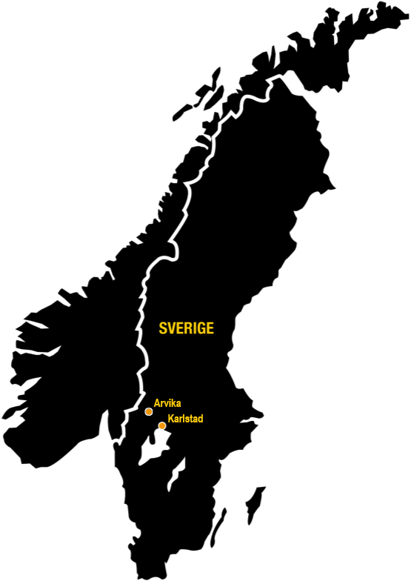
Campus Karlstad
About 19 000 students
265 doctoral students
1 300 Staff
FACULTIES
Faculty of Arts and Social Sciences
Faculty of Health, Science and Technology
The Faculty Board for Teacher Education
Teacher Education – about 25% of the students
Campus Arvika
Ingesund School of Music
about 300 students & 40 teachers

Slide 3

An international University
Collaborations with more than 250 universities around the world
Teacher- student exchange
International visiting professors
Incoming and outgoing students annually

Slide 4

Teacher Education Programmes
Early years Education Programme (210 hp)
Primary Education Programme F-3 (240hp)
Primary Education Programme 4-6 (240hp)
Primary Education Programme- Extended School(180)
Music Teacher Education Programme(300 hp)
Secondary Education Programme- 7-9(240hp)
Upper Secondary Education Programme- gymnasium (300-330 hp)
Vocational Education Programme(90hp)
Secondary school & Primary year 7-9 - Bridging Programme (90hp)

Slide 5
Internationalisation
Internationalisation- an area in focus both mobility and internationalisation at home, challenge for teacher education often mobility windows
important corner stone for students in their professional development to work in a multicultural /multilingual society/preschools/schools
Global South: India, South Africa and Kenya
Initiatied by and strongly depended on enthustiastic individuals
practicum in schools and collecting data for the final papers/or thesis.
As an option - a course for outgoing students preparing for data collection , theory and methods
Students:
Practicum: offered to all students (Pre school, to Upper Secondary schools etc 2-5 weeks
Data collection (writing their final exams, thesis) - to all students
Exchange for a whole semester: Upper secondary teachers
.
Notes:
Visionen står i samklang med universitetets vision och den värdegrund som genomsyrar Karlstads universitets lärarutbildning:
Stark växelverkan mellan teori och praktik för att bygga yrkesidentiteten
Förankring i forskning och samverkan med skolhuvudmännen
Beredskap att verka för en förskola eller skola där alla lär och utvecklas.

Slide 6
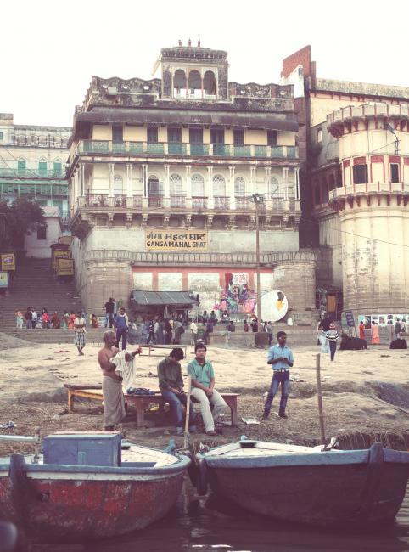
Primary & Secondary Education
VFU 3 (2022)
students practicum(2 v.):
India (7 stud)
South Africa (2 stud)
VFU 2: (2023)
2-5 weeks
Kenya och Indien
12 stud to Kenya

Slide 7
Opportunities & Challenges
Opportunities: there are opportunities but it also comes with challenges!
Challenges : evaluation of credits, to reach students and to inspire them to travel, many students have families, the costs! Difficulties to find mobility windows for students in Primary education /Preschool (taking small babysteps ) Australia)
Research- not much but there are some examples,
Working on mobility windows for each program

