Slide 1
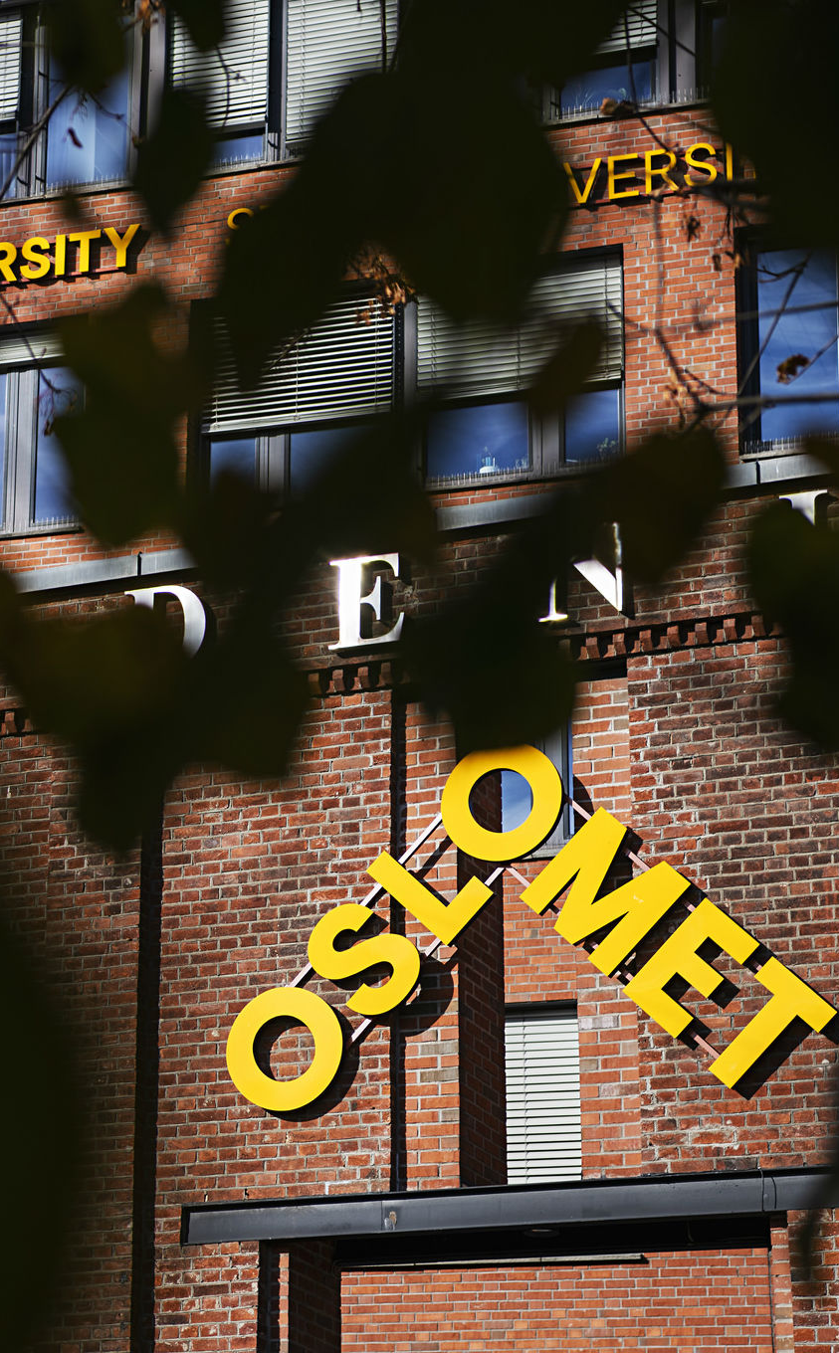
Student teachers practicum in the Global South
Kari Bratland, Hege Knudsmoen and Steinar Mathiesen
29.09.2022

Slide 2
Early childhood teachers practicum in the Global South

Slide 3
Where?
Early Childhood Teachers internship and study, 3-month stay, with exam at OsloMet: Kyambogo University in Uganda and connected ECE institutions Winneba University of Education in Ghana and ECE institutions (schools and kindergartens) (Also VIA University College and Malmø University)

Slide 4
Structure
Weeks 1 and 2: Lectures and seminars in country groups and with all students together
Departure around the 12th of January
Introduction days at the host university
Practice placement in kindergartens or schools, two different placement institutions
Short days in placement
Four days a week
Assignments to be sent home to and graded by OsloMet
A one-week workshop at the host university
Some vacation days and a “travel week”
Seminar and evaluation after returning home in the middle of April

Slide 5
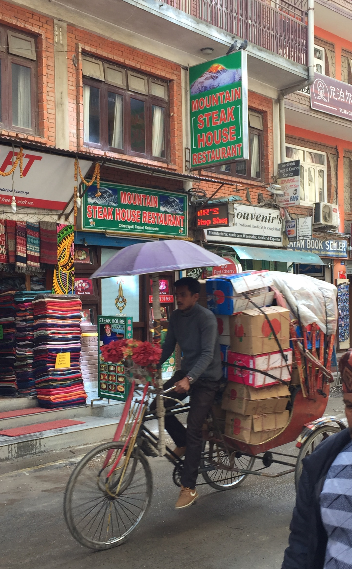
Where?
Primary and Secondary Teachers internship and study stay during a 3-month stay, with exam at OsloMet: Kyambogo University in Uganda and their schools University of Western Cape in South Africa with schools in the Cape-region Tribuhvan University in Nepal and their schools
Feb.- April, international semester 6. semester: Social Science Christianity, Religion, Philosophies of Life and Ethics Digi. ped, Spec.ped, Prof. ped. English (only for MGLU 1-7)

Slide 6
Structure
Start-up month in chosen subjects at OsloMet in January
Departure to the place of practice on 1 February. - 3 months stay, 25 days internship abroad
Introduction days under the auspices of the host university
Independent work with chosen subjects with support from subject teachers at OsloMet, in-depth work and/or other work requirements
A one-week workshop midway under the auspices of OsloMet. 30 credit exams are completed at home, there may be some adaptations of work requirements to sit for the exam cf. study plan.
Practical guidance along the way from a local university and professional follow-up from the subject teachers at OsloMet.

Slide 7
Example
WEEK | MONDAY | TUESDAY | WEDNESDAY | THURSDAY | FRIDAY
3rd-9th Feb |  | Introduction days: separate program, Muizenberg from Cathy
10th-16th Feb | Practice placement/observe start of the school year and assist class teacher | Practice placement/observe start of the school year and assist class teacher | Practice placement/observe start of the school year and assist class teacher School visit/check-up/practicalities at Lourier and Steenberg by Cathy | Studies | Studies
17th-23th Feb | Practice | Practice Advisory visit by supervisor prof. Sam Govender at Steenberg and Lourier | Practice | Studies | Studies
24th -1st Feb/March | Practice | Practice | Practice: | Studies | Studies TWB session with Karen Collett at UWC.
2th-8th March | Practice | Practice Observation by supervisor prof. Sam Govender at Steenberg | Practice Observation by supervisor prof. Sam Govender at Lourier | Studies | Studies
9th-15th March | Practice | Practice | Practice | Studies | Studies
16th-22nd March | Studies La Provence Vineyards B&B | Studies La Provence Vineyards B&B | Studies La Provence Vineyards B&B | Studies La Provence Vineyards B&B | Studies La Provence Vineyards B&B
23th-29nd March | OsloMet Student workshop | OsloMet visit Practice Steenberg | OsloMet visit Practice Lourier | OsloMet student workshop | OsloMet workshop for teachers and students?
30th-5th March/Apr. | Day at own disposal/study day | Day at own disposal/study day | Day at own disposal/study day | Day at own disposal/study day | Day at own disposal/study day
6th-12th April | Day at own disposal/study day | Day at own disposal/study day | Day at own disposal/study day | Day at own disposal/study day | Day at own disposal/study day
13th-19th April | Practice | Practice | Practice | Studies TWB session with Karen Collett at UWC. |  | Studies
20th- 26th | Practice | Practice Observation by supervisor prof. Sam Govender at Steenberg | Practice Observation by supervisor prof. Sam Govender at Steenberg | Studies |  | Studies TWB session with Karen Collett at UWC.
27 th-3rd April/May | Practice | Practice | Practice

Slide 8
Preparations autumn
Activity
OsloMet central: Feltforberedende kurs
Information among history, school system and -context 2+2 per country
Lectures Intercultural competence withTonje Myrebøe Global consciousness with Mette Helleve Ethics with Agnethe Elisabeth Steineger
OsloMet central: utreiseseminar in December

Slide 9
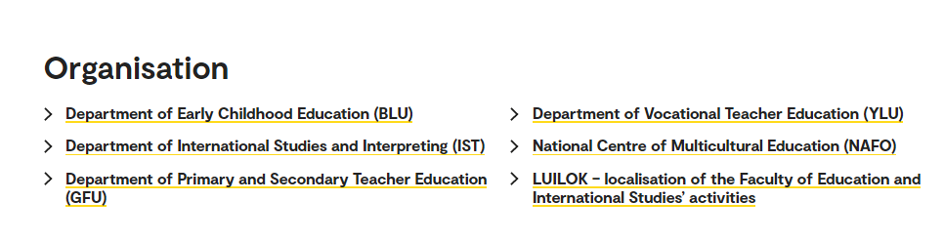
Faculty of Education and International Studies – LUI: OsloMet

Slide 10
Research
Teacher well being
Collaborative online international learning (COIL)
Smaller research projects and articles written by the lecturers

Slide 11

COIL: EX. DIGITAL STORIES - in corporation with UWC
The specific aims of this virtual exchange:
develop global online teaching and critical citizenship and awareness in collaboration.
develop a digital story related to teaching in diverse and global classrooms and multicultural learning environments.
reflect upon the value of traditional stories and indigenous knowledge and respect for local language and heritage.
explore cultural and linguistic diversity through collaborative learning.

