Slide 1
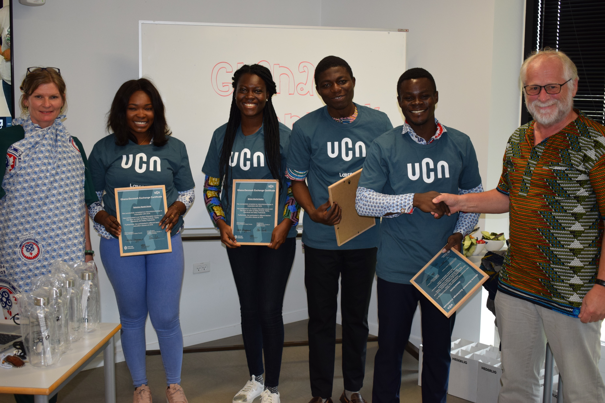
University College Northern Denmark
Collaboration with the global south

Slide 2
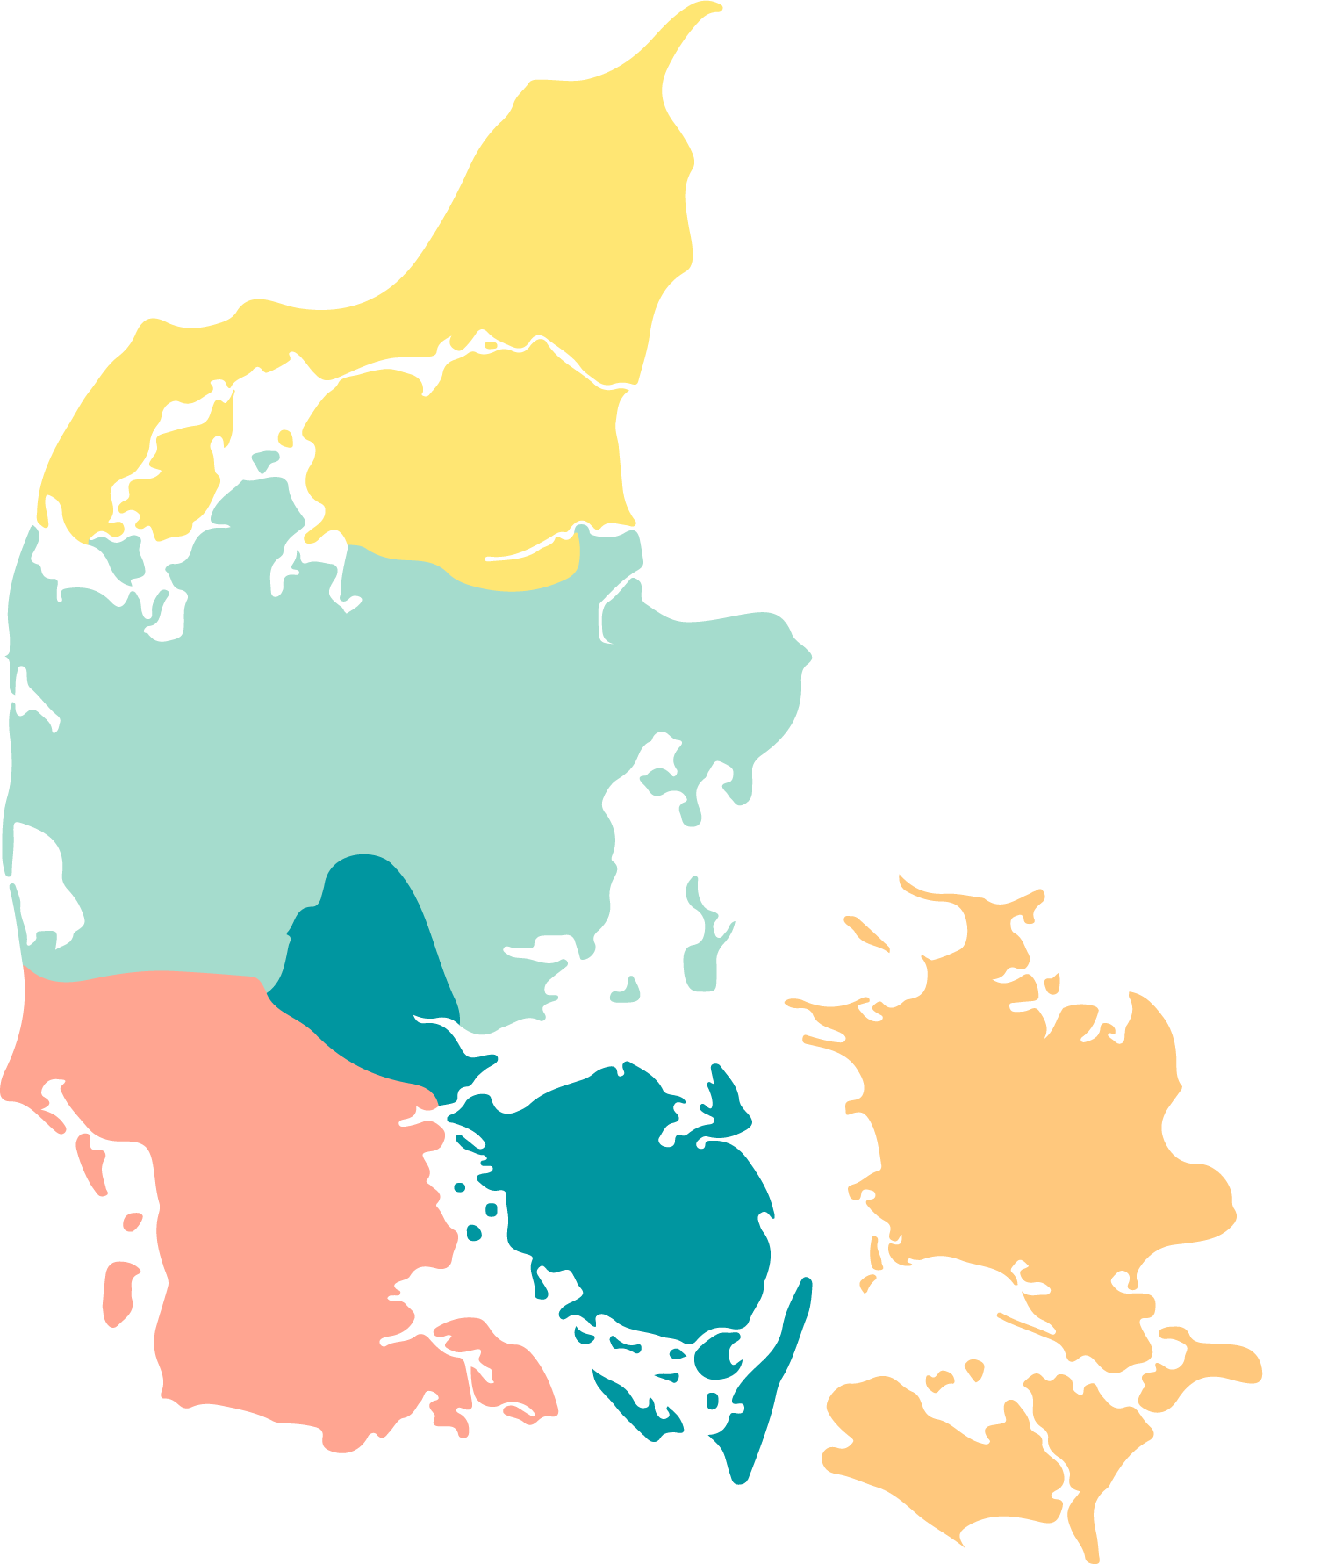
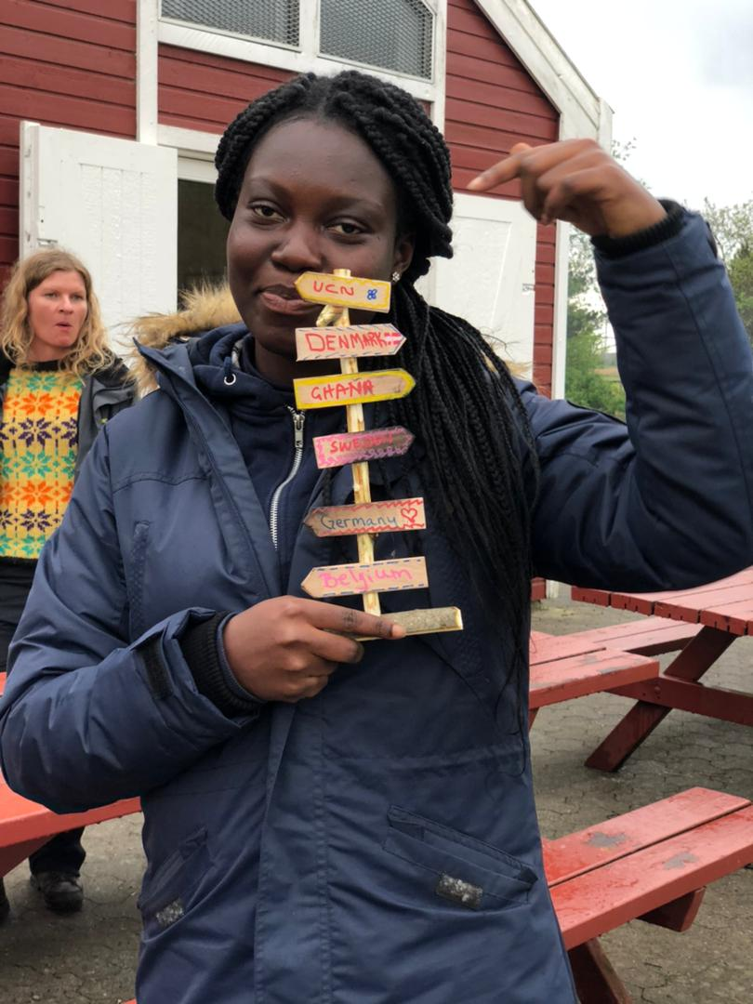

University colleges in Denmark
University College of Northern Denmark
VIA University College
University College Copenhagen
UCL University College
University College South Denmark
Danish School of Media and Journalism
University College Absalon

Slide 3

University College of Northern Denmark (UCN) is:
Education and continuing education
Research and development
Innovation
Education and social education
Healthcare
Business
Technology
Within…

Slide 4
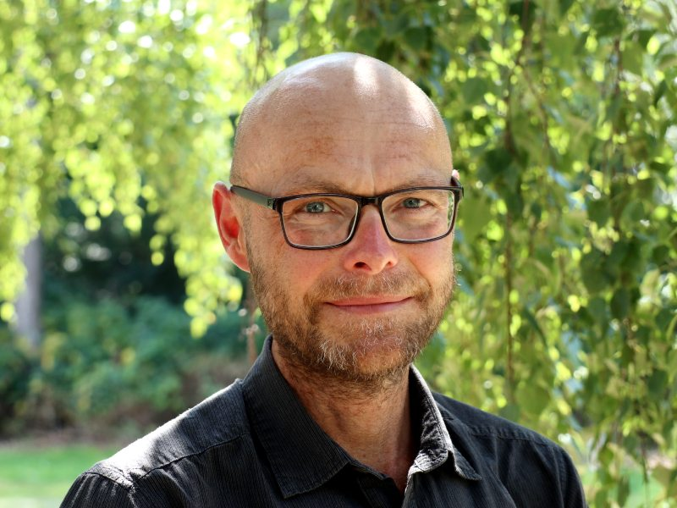
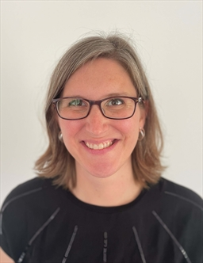
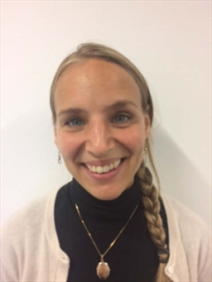
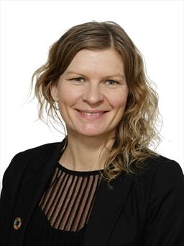
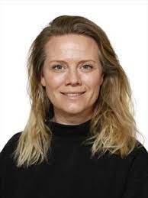
Who is involved from UCN’s Teacher Education?
Thomas Kjærgaard, PhD
Associate Lecturer in English
Key-areas: Technology in teaching and learning, Reflective Practise based learning (RPL)
Implements COIL in teaching (Japan, UK, and now Ghana)
Part of the Nordplus project team (GLOSS)
Ariana Ward Jespersen
Assistant Lecturer in English
Key-areas: Intercultural competence & Language acquisition
Will implement COIL into teaching this spring with Ghana (Pilot)
Lisa Rygaard Kristensen, PhD
Associate Lecturer in English
Key-areas: Intercultural competence and Globalization, Philosophy with children
Will implement COIL into teaching this spring with Ghana (Pilot)
Anne Lassen Zakaria, PhD
Assistant Lecturer in Danish as second language, international coordinator
Key-areas: Intercultural competence and Internationalization
Will implement COIL into teaching this autumn with Ghana (Pilot)
Christina Elisabeth Mundbjerg
Assistant Lecturer in English
Key-areas: Intercultural competence and Internationalization
Will implement COIL into teaching this autumn with Ghana (Pilot)

Slide 5
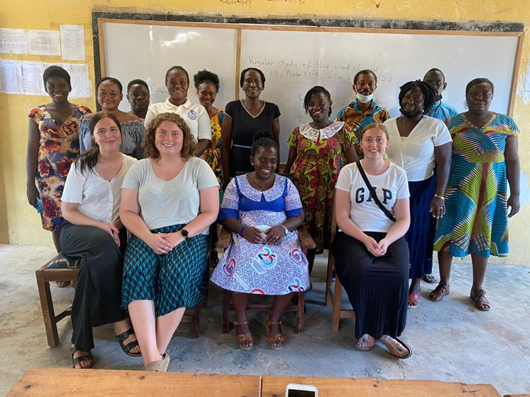
International practicum
During the 4 years of education, students have 3 practicum periods of 6 weeks each time.
The competence areas of all of these are:
Didactics
Classroom Management
Relational Work
The three teaching practice levels together make up 30 ECTS points.
First level is obligatory in a Danish folkeskole
Level 2 and/or 3 are more open and students can choose a practicum abroad
Around 40 students go abroad for an international practicum

Slide 6
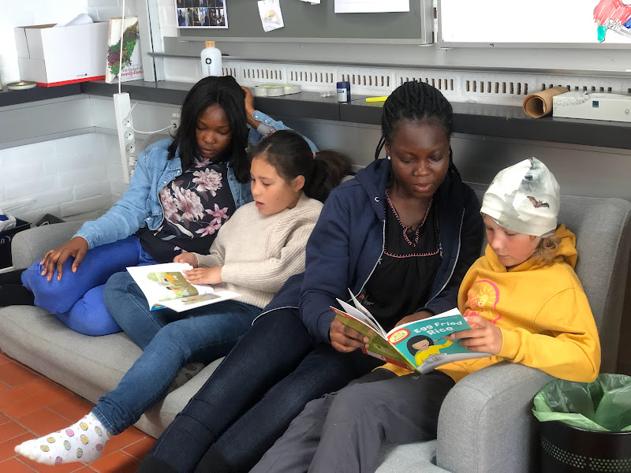
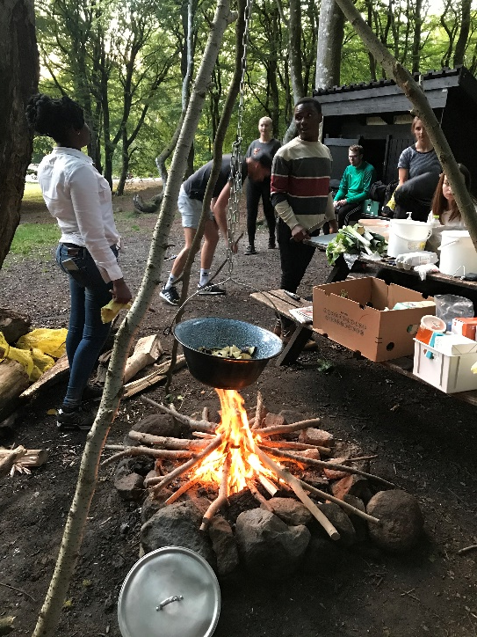
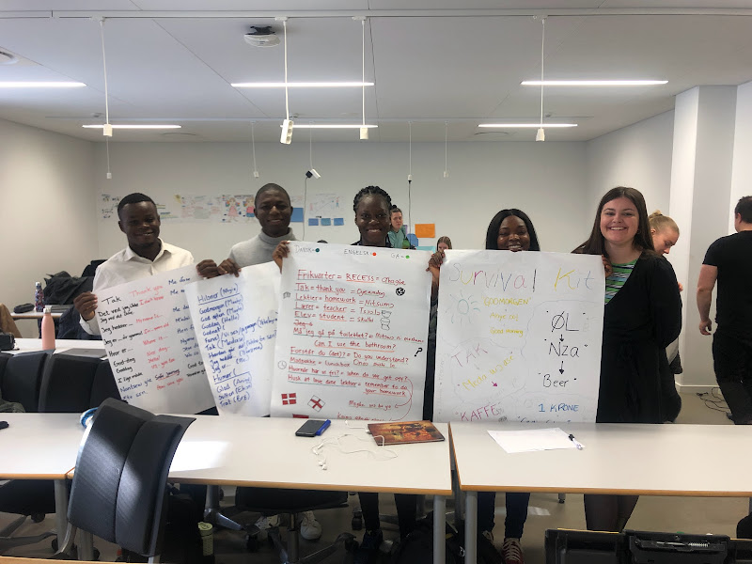
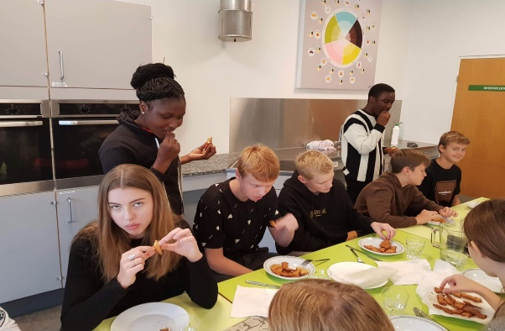
Where do our students go for international practicum?
Ghana, Zambia, India, Australia, Japan, Israel/Palestine, Holland, UK, Germany, Canada, Norway, Greenland, Faroe Islands, Iceland, and more…
Most often we have direct collaboration with the practicum schools
In Ghana, Japan and Israel the practicums are established through our partner universities
In GLOSS we focus on our collaboration with University of Education, Winneba in Ghana

Slide 7
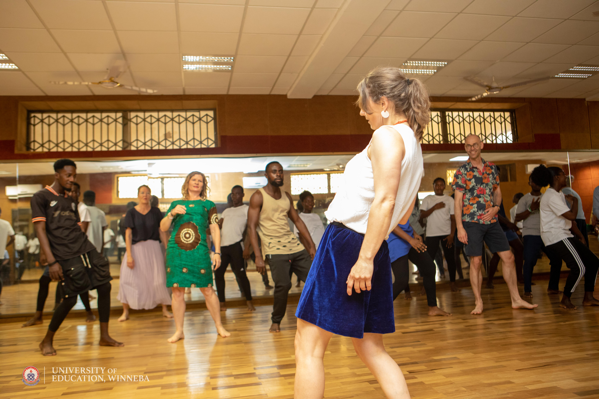
What have we gained so far quantitatively
In terms of physical mobility:
5 students have been to UEW from UCN
6 students have been to UCN from UEW
1 staff member has been to UCN from UEW
12 staff members from UCN have been to UEW
In 2022/23:
4 students are going to UEW from UCN,
4 students are going to UCN,
3 staff UEW to join UCN international days
3 UCN staff going to UEW in 2023

Slide 8
Challenges
teacher strikes
Normative practices
Pandemic
diversity in work ethics
clash in academic calendars and timings
Management bureaucratic processes, budget cuts and resource scarcity
Difficult to get UCN students to go for a semester at UEW – the two that went came back!!
Institutional support
Driven by network and ”ildsjæle”
Visa procedures – for south partners

Slide 9
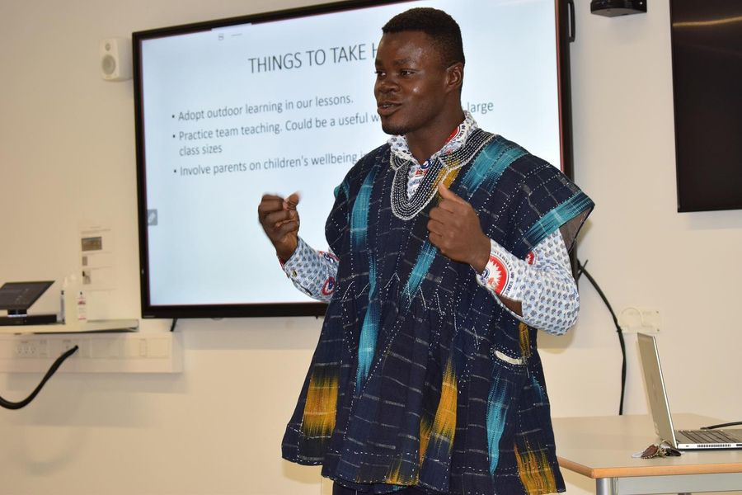
A story: from institutional collaboration to friendships & gifts
Samuel Enchill – Art Student from University of Education, Winneba

Slide 10
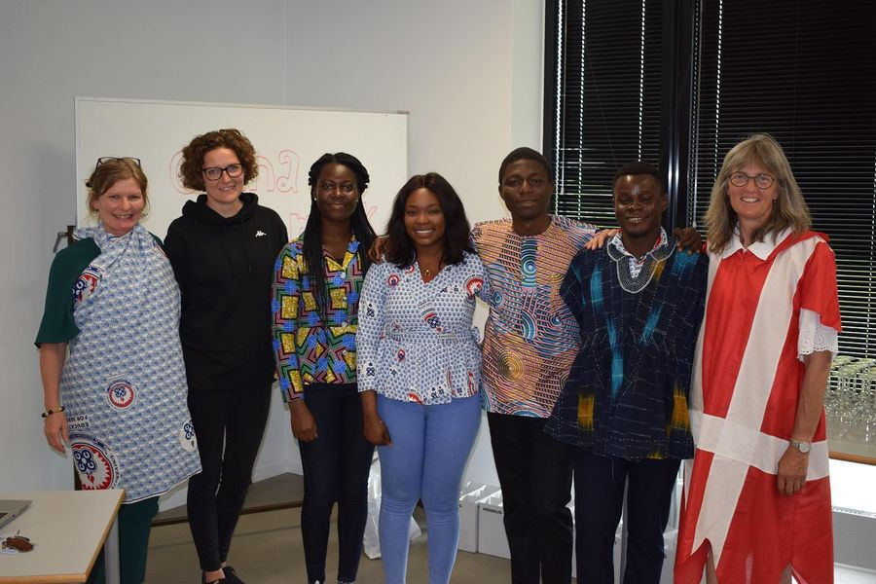
At the final open reflection seminar

Slide 11
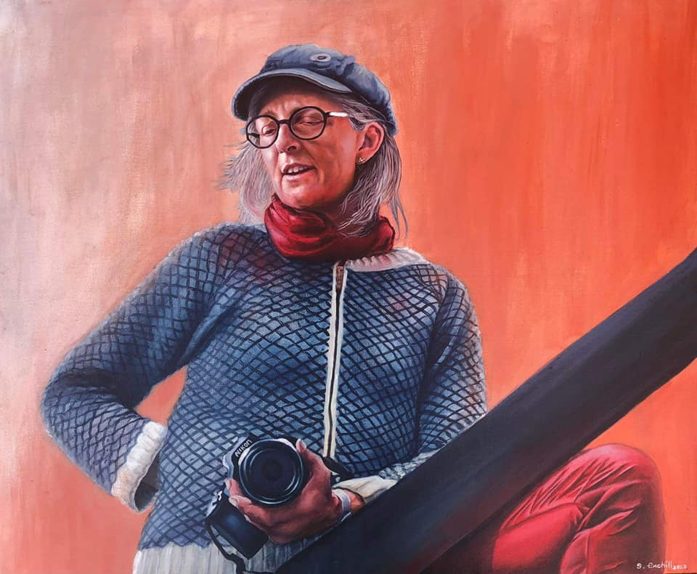
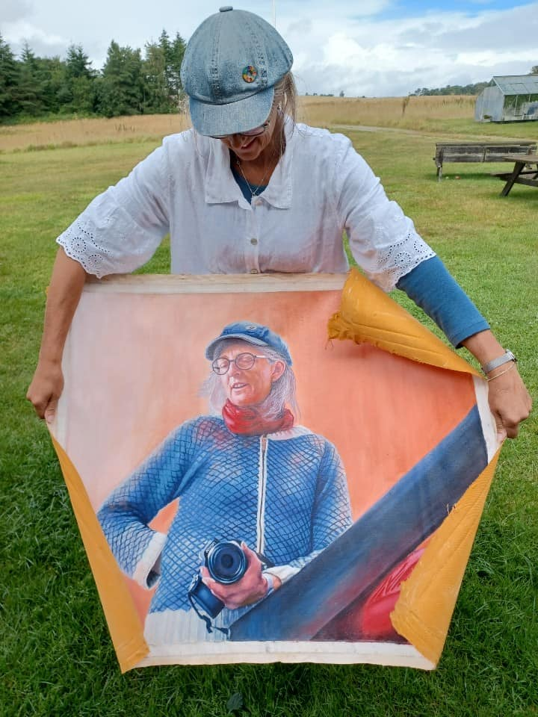
A gift to the school-principal from Samuel

Slide 12
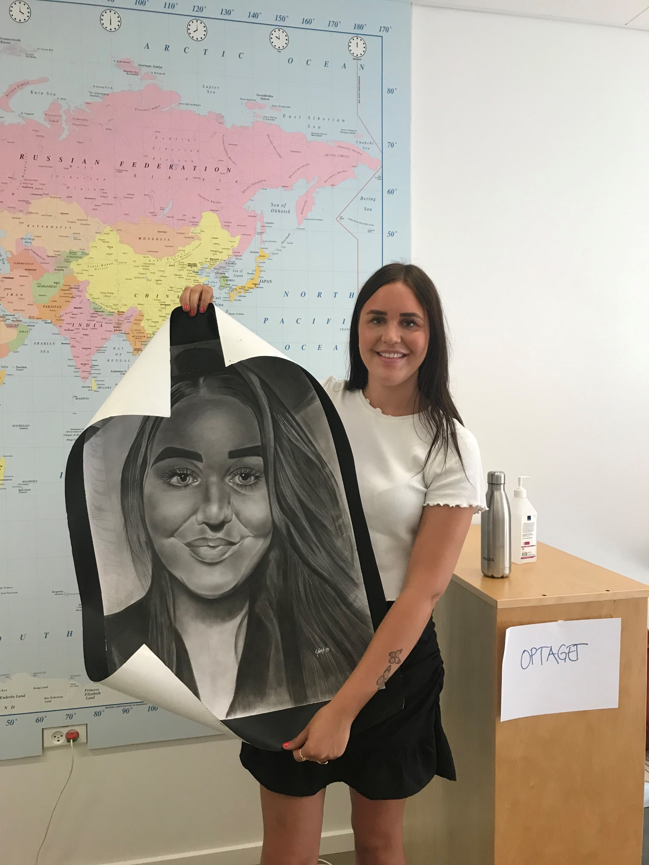
Julie from UCN – practicum in Ghana – gift-giving

Slide 13
GLOSS contributions
Support in terms of Reflective Practise Based Learning and COIL/virtual mobility
Co-research with AAU and GLOSS network & south partners
Extend the UCN network of global south partners to GLOSS
Co-facilitate external funding applications – Equity in mobility and education
Interested perspectives that include the global south voices to a higher extend
Perhaps look at staff mobility in addition to student mobility
Include elementary schools in addition to teacher students

Slide 14
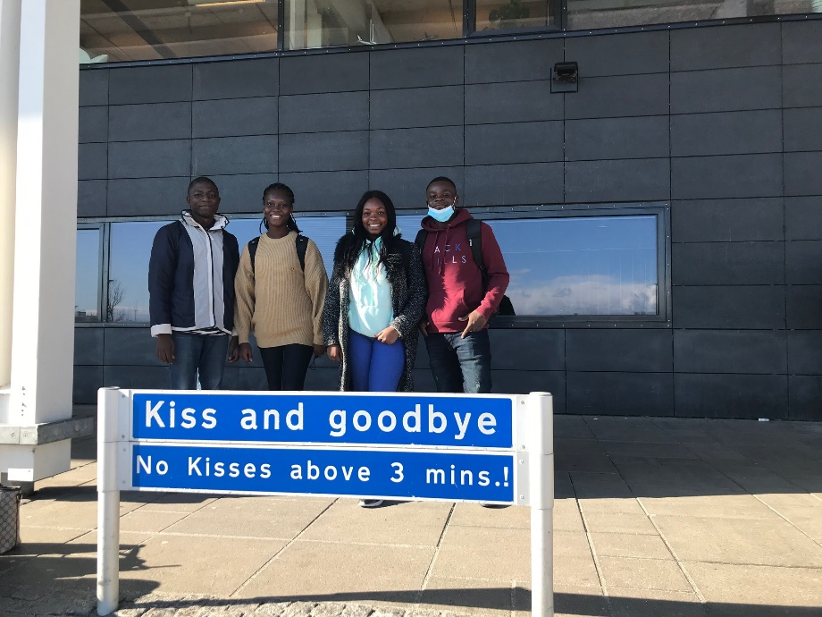
Thank you ☺

