Slide 1
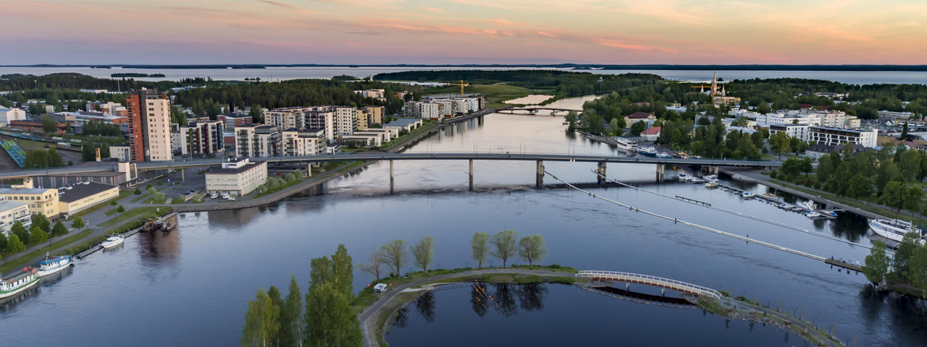
GLOSS
Kuopio
Kaisa Pihlainen, Calkin Suero Montero, Lotta Aavikko, UEF
Joensuu

Slide 2
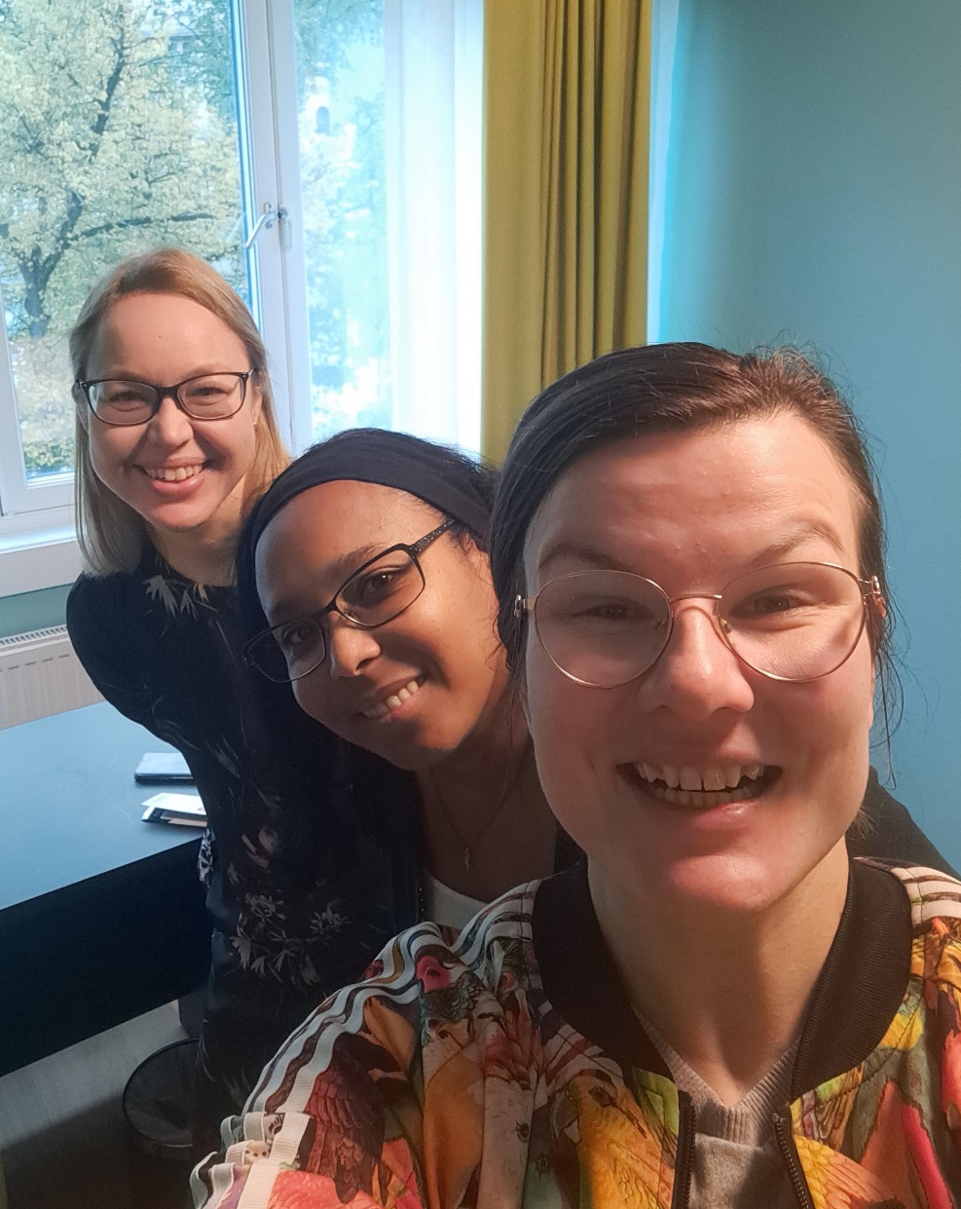

Slide 3
UEF’s key figures
4
faculties
13
fields of study
100
major subjects
2,700
members of staff
15,500
degree students
17,700
adult education students
1,200
international
degree students
3,167
degrees awarded
in 2019
2,644
scientific
publications in 2019

Slide 4
Organisation of the University of Eastern Finland
Philosophical Faculty
Faculty of Science
and Forestry
Faculty of Health Sciences
Faculty of Social Sciences and Business Studies
School of Humanities
School of Educational Sciences and Psychology
School of Applied Educational Science and Teacher Education
School of Theology
Teacher training school of the University of Eastern Finland
Department of Physics and Mathematics
Department of Applied Physics
Department of Chemistry
School of Forest Sciences
School of Computing
Department of Environmental and Biological Sciences
SIB Labs
A.I. Virtanen Institute for Molecular Sciences
School of Pharmacy
Department of Nursing Science
School of Medicine
Department of Geographical and Historical Studies
Business School
Law School
Department of Health and Social Management
Department of Social Sciences
Karelian Institute

Slide 5
Organisation of the University of Eastern Finland
Philosophical Faculty
Faculty of Science
and Forestry
Faculty of Health Sciences
Faculty of Social Sciences and Business Studies
School of Humanities
School of Educational Sciences and Psychology
School of Applied Educational Science and Teacher Education
School of Theology
Teacher training school of the University of Eastern Finland
Department of Physics and Mathematics
Department of Applied Physics
Department of Chemistry
School of Forest Sciences
School of Computing
Department of Environmental and Biological Sciences
SIB Labs
A.I. Virtanen Institute for Molecular Sciences
School of Pharmacy
Department of Nursing Science
School of Medicine
Department of Geographical and Historical Studies
Business School
Law School
Department of Health and Social Management
Department of Social Sciences
Karelian Institute

Slide 6
Organisation of the University of Eastern Finland
Philosophical Faculty
Faculty of Science
and Forestry
Faculty of Health Sciences
Faculty of Social Sciences and Business Studies
School of Humanities
School of Educational Sciences and Psychology
School of Applied Educational Science and Teacher Education
School of Theology
Teacher training school of the University of Eastern Finland
Department of Physics and Mathematics
Department of Applied Physics
Department of Chemistry
School of Forest Sciences
School of Computing
Department of Environmental and Biological Sciences
SIB Labs
A.I. Virtanen Institute for Molecular Sciences
School of Pharmacy
Department of Nursing Science
School of Medicine
Department of Geographical and Historical Studies
Business School
Law School
Department of Health and Social Management
Department of Social Sciences
Karelian Institute

Slide 7
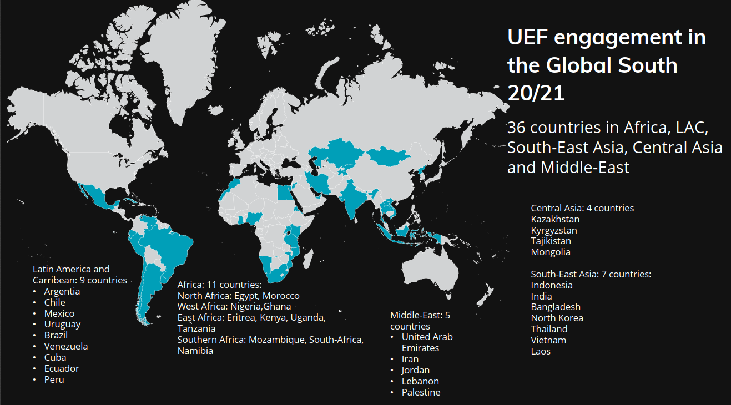

Slide 8
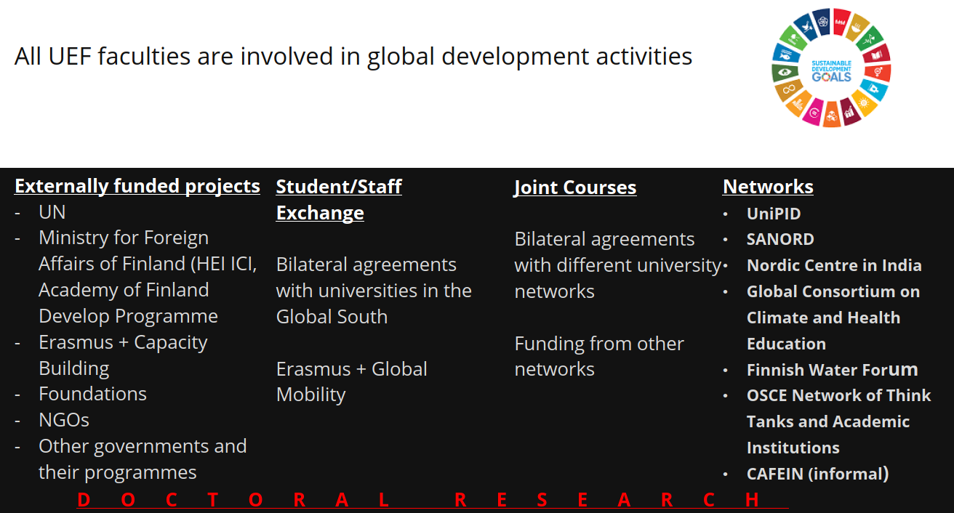

Slide 9
GINTL
The Global Innovation Network for Teaching and Learning (GINTL) brings together dedicated researchers and practitioners from Finland and our partners from China, India and the African continent.
We want to contribute towards achieving the Sustainable Development Goal 4: “Ensuring inclusive and equitable quality education and promote lifelong learning opportunities for all”.
More information: cloneria.jatileni@uef.fi

Slide 10

Tack Thank you Kiitos

