Slide 1
University of Oulu GLOSS
Prof. Elina Lehtomäki, Johanna Lampinen & Joffy Conolly

Slide 2
Current involvement
~240 teacher education students per year
Teacher Education (Finnish) 120; Music Education (in Finnish) 20; Early Childhood Ed (Finnish) 100; Intercultural Teacher Education (in English) 20
Mainly Erasmus + programmes (Students get support from university to all countries/places)
GINTL India, Namibia, South Africa – see gintl.org
We receive ~80 exchange students / year
Length of practicum
Study exchange, one term (September-December or January – May) 3 or 6 months,
Internship – optional studies for TE students (4th or 5th year)
Teaching practice (2nd year) / Thematic practice 5 week minimum (support from the University of Erasmus Mobility fund minimum 2 month)

Slide 3
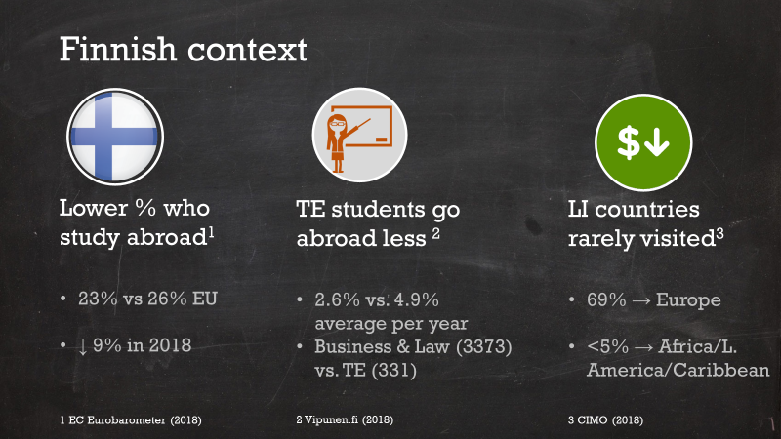

jultika.oulu.fi/Record/isbn978-952-62-2874-7

Slide 4
Lower income countries - key issues
Lack of bilateral study agreements
only 9/70 Lower income countries are represented.
only 5/9 unis have agreements with any LI country
Lack of knowledge about these countries
Security concerns
Quality (of courses)
Pre & post- support is crucial

Slide 5
Our aims for this project
Ethics of internationalisation – should we be sending abroad?
Environmental issues over airmiles? Virtual vs practical?
Concerns over imbalance / power inequalities
What should / do students learn?
Academic / personal growth / intercultural & decolonial thinking
Get new ideas from others

