Slide 1
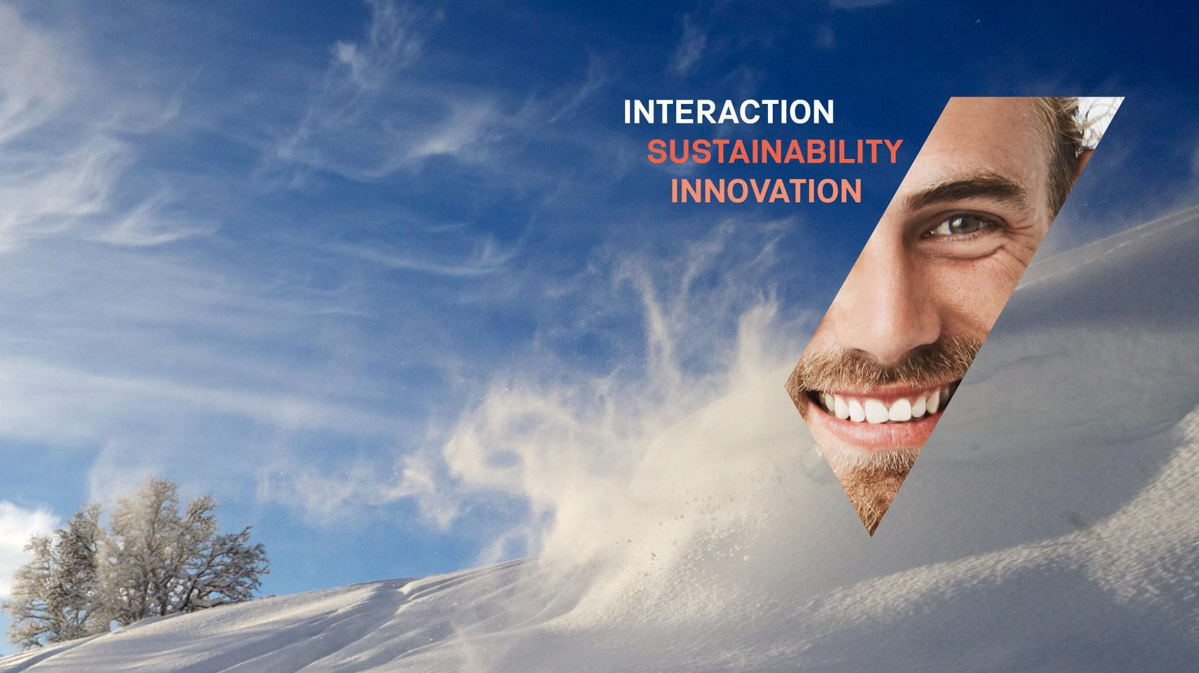

Project meeting
Global Teaching for Sustainable Society (GLOSS)
OsloMet 29th September 2022
Western Norway University of Applied Sciences (WNUAS or HVL)
Ane Bergersen & Monica Vattedal
Faculty of Teacher Education, Culture and Sports
Campus Sogndal

Slide 2
Who are we?
Monica Vattedal – English literature and intercultural communication
  monica.tove.vattedal@hvl.no
  Lecturer and facilitator both «Global Knowledge» and «Education and Sustainability»
  Supervision – student project papers.
Ane Bergersen – Sociologist and intercultural competence
  ane.bergersen@hvl.no
Lecturer and facilitator both «Global Knowledge» and «Education and Sustainability»
Coordinator for both programmes (Sogndal) and follow-up students in Zambia

Slide 3
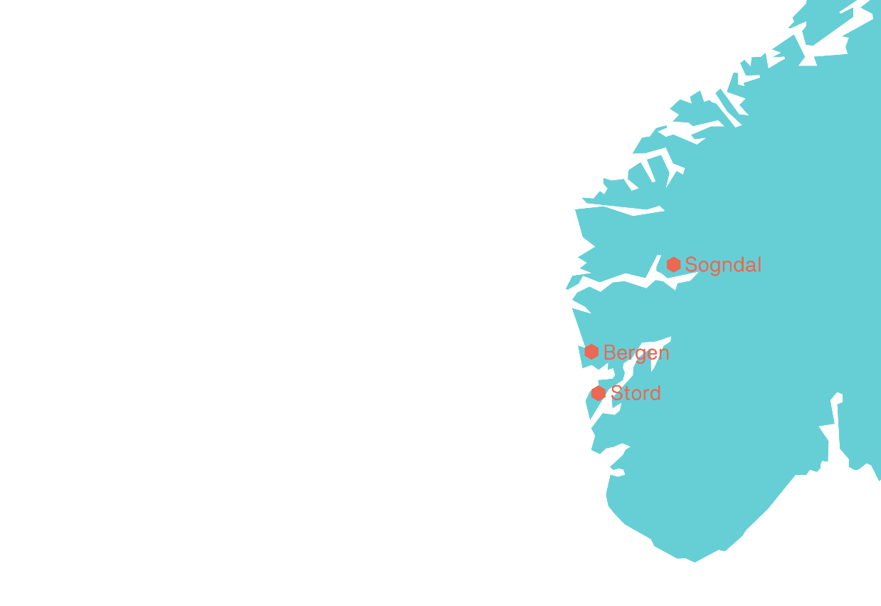
Fakultet for lærarutdanning, kultur og idrett (FLKI)
6000 studentar
600 tilsette
Fire institutt
Fem forskingsprogram
Forskingssenter
Campus Sogndal, Bergen og Stord
Notes:
Mål med arket
Å vise sentrale nøkkeltal og organiseringa av fakultetet.
Stikkord
Fakultet for lærarutdanning, kultur og idrett, (FLKI) har om lag … studentar og …tilsette fordelt på tre campusar – Sogndal, Bergen og Stord.
FLKI har eit studietilbod frå bachelor til ph.d. og bidrar også inn i utdanningsprogram ved dei andre fakulteta ved høgskulen.
Fakultetet er organisert med fire institutt og tre forskingssenter
Institutt for idrett, kosthald og naturfag
Institutt for kunstfag
Institutt for pedagogikk, religion og samfunnsfag
Institutt for språk, litteratur, matematikk og tolking

Slide 4
Student mobility to the Global South
At WNUAS (Vestlandet) students stay three months abroad as part of a 30 ECTS programme
Teacher Education, teaching grade 1-7 and 5-10 - in their fifth semester - select a school-relevant course, like Education and Sustainability with practice in Africa (30 ECTS including three months in Tanzania (or Zambia))
  Students and lecturers from three campuses, Stord, Bergen & Sogndal. (Vestlandsklasse)
  First time autumn 2019, this year and next year etc.
  Student group size 20 – 30 students each year.
  Based on more than 10 years’ experience with 3-4 weeks’ practice in Tanzania and Global Knowledge with 3 months in Zambia.
Preschool Education can in their sixth semester select Global Knowledge BLU three weeks theory, a three months’ stay in Zambia and summing up after returning home (two weeks).

Slide 5
Short history and background of Global Knowledge and cooperation with partners in Zambia
Student exchange agreement from 2002 (DALICE, Zambia)
  Teacher students 4 weeks since 2004 – 2006
Rector at the University College argues in line with the White paper (2008) Internationalization in higher education in Norway to change shorter stays to minimum 3 months as part of a 30 ECTS course.
2008 – 2016 Global Knowledge. students from Zambia to Norway (1 year), and from Norway to Zambia (3 months)
2016 – 2020 Global Knowledge Norwegian students to Zambia
2021 - Global Knowledge BLU Norwegian Early Childhood Education students to Zambia ( from 3 different campuses (Bergen, Sogndal & Stord).
Total 93 Zambian students 1 year in Norway (Sogndal), 250 Norwegian students to Zambia (GKB) and 50 students to Tanzania (Education and Sustainability) 2019 + 2022.

Slide 6
Education and Sustainability & Global Knowledge BLU
Common denominators:
3 months’ stay in Tanzania or Zambia
4 – 6 weeks teaching practice (4 days a week)
1 – 2 weeks at the local teacher education (Livingstone/ Moduli)
Project as part of exam (20 pages, data collection and related to UN’s Sustainable Develoment Goals/ intercultural understanding)
Learning outcome/aim: Intercultural communication & competences, global awareness, sustainable development, learning and teaching in different cultures, society – individual reflections etc.
30 ECTS courses developed based on experiences with a few weeks practice and research on student mobility (own and international).

Slide 7
Research on student mobility
Recent research published in Klein, Bergersen & Larsen: Utenlandspraksis for lærerstudenter. Global og interkulturell kompetanse
  Chapter 1 Introduction. General research and Norwegian policy (Some research based on Global Knowledge students, to and from Zambia).
  Chapter 3 Norwegian and Zambian students’ positions and perspectives as Global Knowledge students. White privileges and power.
  Chater 5 Intercultural communication (Education and Sustainability students).
  Chapter 8 Education for Sustainable development (Education and Sustainability students’ answers).
Other research on our own student mobility in Bergersen 2013, 2014, 2015, 2016, 2017 and Bergersen & Muleya (2019)
Agreements with David Livingstone College of Education (DALICE), and University of Zambia (UNZA), (research and student mobility).
    Monduli, schools in Arusha and Dar-es-Salaam, Tanzania (student mobility)

Slide 8
Other student mobility activities at WNUAS
Exchange programme with KwaZulu-Natal, South Africa, both ways including research
  Erlend Eidsvik & Espen Helgesen, Campus Bergen
  Olav Christian Ruus, Campus Stord
Team Global Knowledge/Education and Sustainability
  Vibeke Vågenes - coordinator, campus Bergen
  Jacob Melting, Monica Skaten, Thor Erik Sortland and Anne Grethe Sønsthagen
Shorter teacher practice periods in Tanzania (in the past), Arusha
  Jacob Melting, Chapter 9 in Klein, Bergersen & Larsen (2022).
        Questions?

Slide 9
Thank you!

